Slide 1

Data Destruction

Slide 2
Data destruction and media sanitization
Legal issues
What can or cannot be destroyed
Must be done in a legal way
Be careful what you just place in the trash
Dumpster divers
Recycling old drives can still contain data
Policies for this are important
Companies must have procedures in place to protect the companies private data

Slide 3
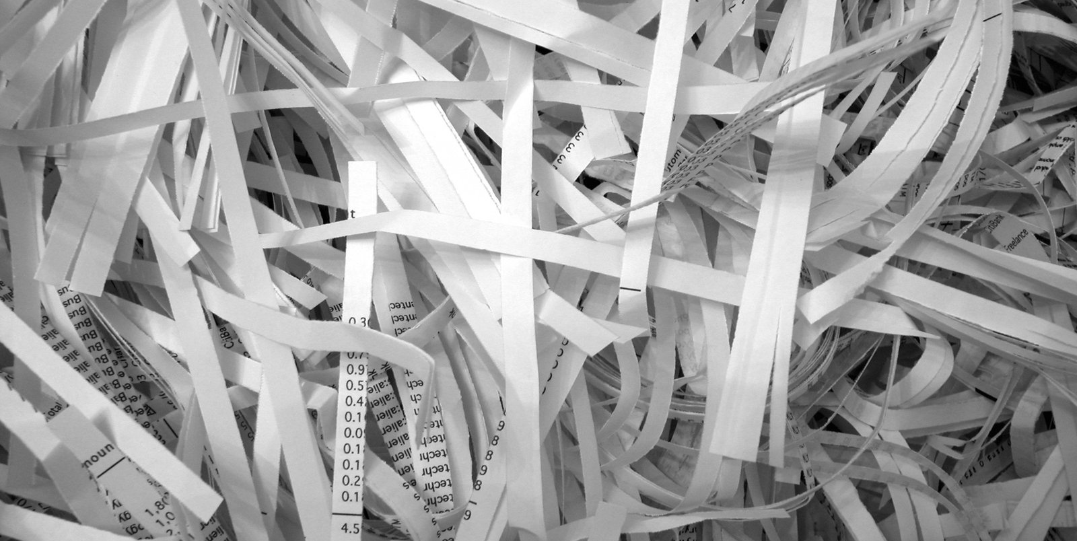
Physical destruction
Burning
Destroyed by fire
Data gone forever, irrevocable
Usually shredded first also
Shredding
Tearing into multiple tiny pieces
Must be careful with shredding important papers
Who is shredding?
Is shred pattern sufficient?
Can pieces be (carefully) reassembled?

Slide 4
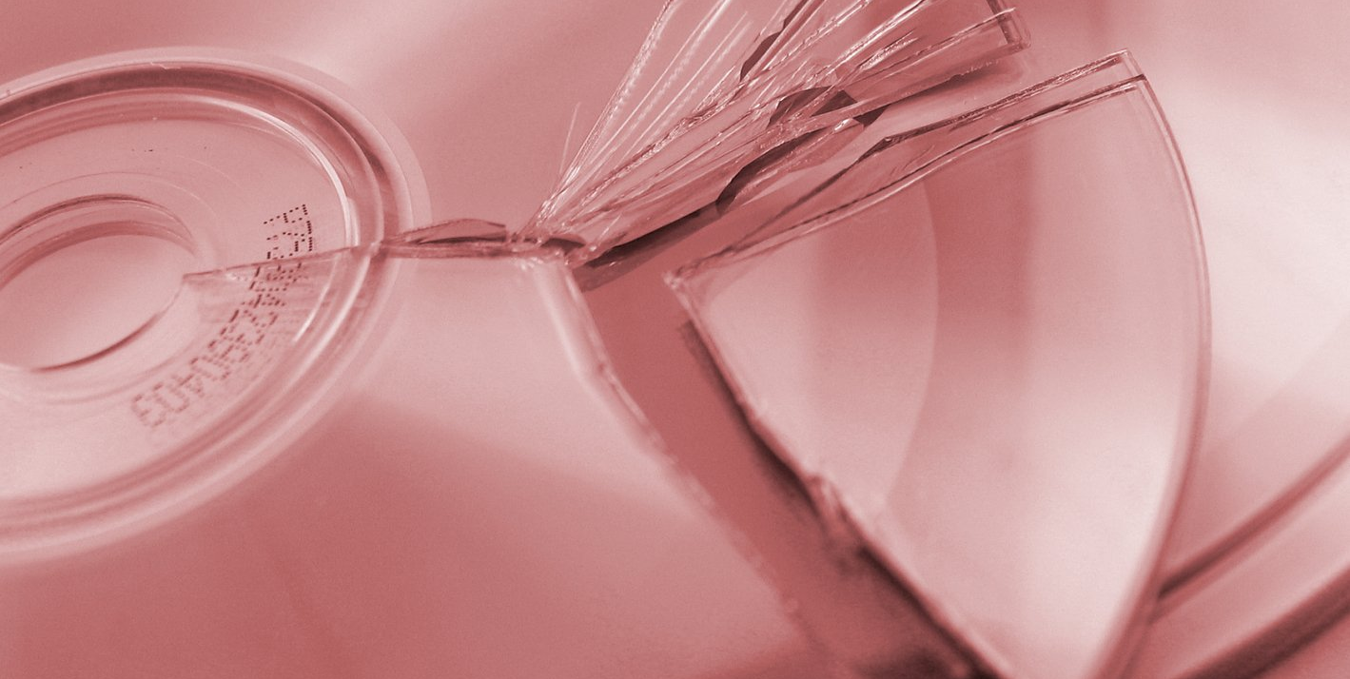
Physical destruction
Pulping
Paper fibers suspended into chemical and recombined into new paper
Destroys physical layout of old paper
Pulverizing
Destruction using excessive force to break part into unusable pieces
Cannot be reconstructed

Slide 5
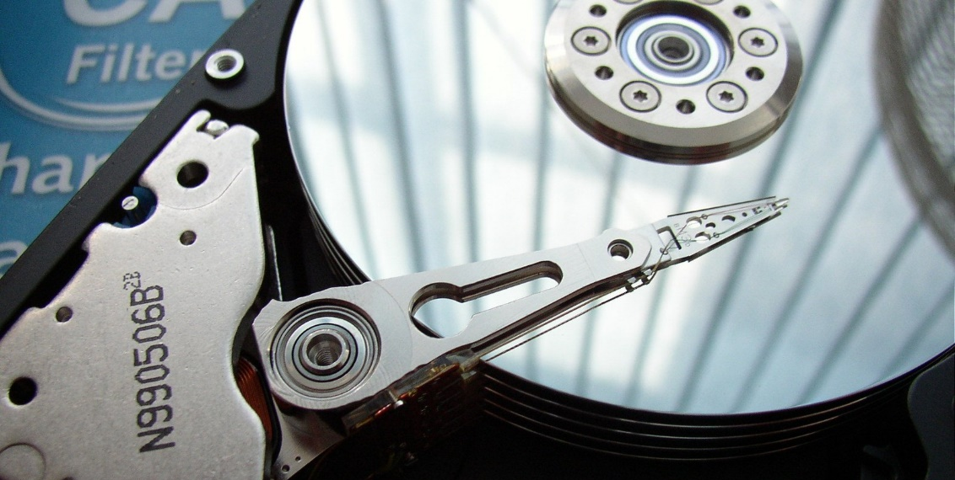
Sanitizing media
Degaussing
Realigning magnetic particles
Destroys all the data
Purging
Removing all data from storage space
Overwriting old data
Wiping
Rewriting data with patterns of 1s and 0s
Multiple passes

